Slide 1
CSE4004 – Web Technologies
Module IV

Slide 2
Cookies
An HTTP cookie (also called web cookie, Internet cookie, browser cookie, or simply cookie) is a small piece of data stored on the user's computer by the web browser while browsing a website.
Cookies were designed to be a reliable mechanism for websites to remember stateful information.
They can also be used to remember pieces of information that the user previously entered into form fields, such as names, addresses, passwords, and payment card numbers.
A cookie is a small file with the maximum size of 4KB that the web server stores on the client computer.

Slide 3
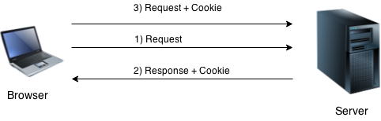
Cookies
Cookie is created at server side and saved to client browser.
Each time when client sends request to the server, cookie is embedded with request.
Such way, cookie can be received at the server side

Slide 4
PHP Cookies
In short, cookie can be created, sent and received at server end.
PHP setcookie() function is used to set cookie with HTTP response.
Once cookie is set, you can access it by $_COOKIE superglobal variable.
A cookie is created with the setcookie() function with the following syntax:
setcookie(name, value, expire, path, domain, secure);
We also use the isset() function to find out if the cookie is set.
To delete a cookie, use the setcookie() function with an expiration date in the past

Slide 5
PHP Cookies
setcookie(name, value, expire, path, domain, secure);
Name: It is used to set the name of the cookie.
Value: It is used to set the value of the cookie.
Expire: It is used to set the expiry timestamp of the cookie after which the cookie can’t be accessed.
Path: It is used to specify the path on the server for which the cookie will be available.
Domain: It is used to specify the domain for which the cookie is available.
Security: It is used to indicate that the cookie should be sent only if a secure HTTPS connection exists (httponly)

Slide 6
PHP Cookies
bool setcookie ( string $name [, string $value [, int $expire = 0 [, string $path [, string $domain [, bool $secure = false [, bool $httponly = false ]]]]]] )
setcookie("CookieName", "CookieValue", time()+1*60*60, "/mypath/", "mydomain.com", 1);
setcookie("Auction_Item", "Luxury Car", time()+2*24*60*60);
if(isset($_COOKIE["Auction_Item"])){
echo "Auction Item is a " . $_COOKIE["Auction_Item"];
} else{
echo "No items for auction.";
}
setcookie("Auction_Item", "", time()-60);

Slide 7
Session
PHP session is used to store and pass information from one page to another temporarily (until user close the website).
PHP session technique is widely used in shopping websites where we need to store and pass cart information e.g. username, product code, product name, product price etc from one page to another.
PHP session creates unique user id for each browser to recognize the user and avoid conflict between multiple browsers.

Slide 8
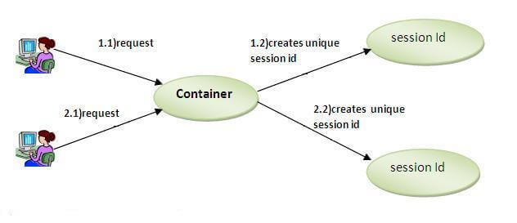
Session

Slide 9
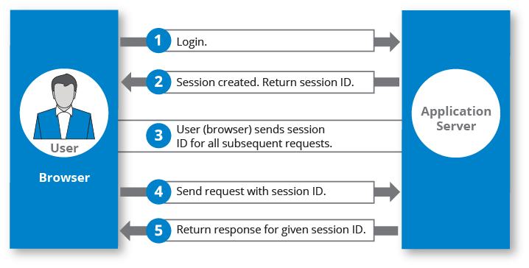
Session

Slide 10
PHP Session
A session is started with the session_start() function.
Session variables are set with the PHP global variable: $_SESSION.
All session variable values are stored in the global $_SESSION variable.
$_SESSION[“variablename"] = “value";
echo $_SESSION[“variablename"]
To remove all global session variables and destroy the session, use session_unset() and session_destroy()

Slide 11
PHP session_start() function
PHP session_start() function is used to start the session. It starts a new or resumes existing session. It returns existing session if session is created already. If session is not available, it creates and returns new session.
Syntax bool session_start ( void )
Example session_start();
PHP $_SESSION is an associative array that contains all session variables. It is used to set and get session variable values.
Example: Store information
$_SESSION["user"] = "Sachin";
Example: Get information
echo $_SESSION["user"];

Slide 12
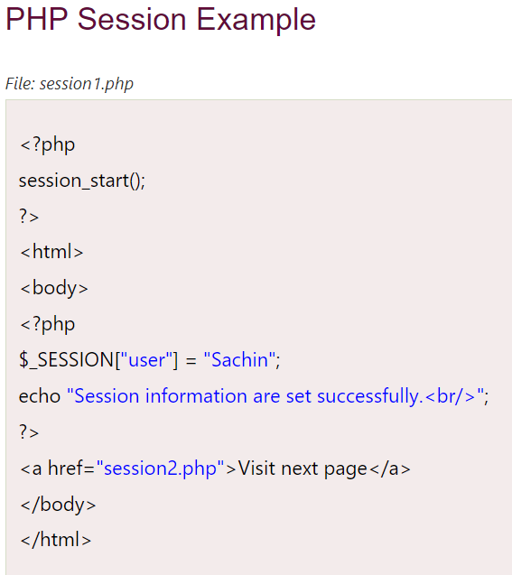
PHP session_start() function

Slide 13
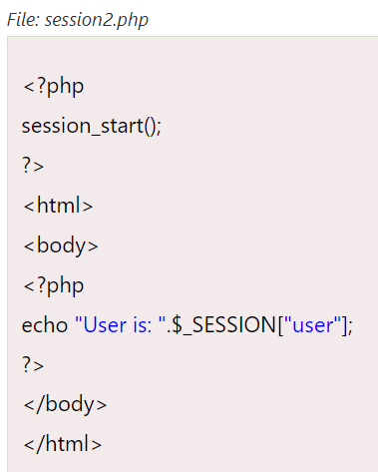

Slide 14
Functions
A function is a self-contained block of code that performs a specific task.
PHP has a huge collection of internal or built-in functions that you can call directly within your PHP scripts.
In addition to the built-in functions, PHP also allows you to define your own functions.

Slide 15
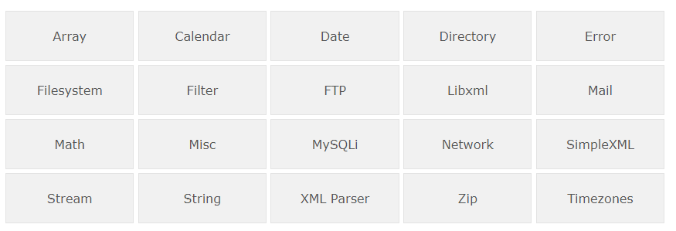
Internal / Built-in Functions

Slide 16
Internal / Built-in Functions
<?php
echo "Today is " . date('l', mktime());
?>
The date() function formats a local date and time, and returns the formatted date string
mktime() function is useful for doing date arithmetic and validation

Slide 17
User-defined functions
A user-defined function declaration starts with the word function.
function functionName() { code to be executed; }
A function name must start with a letter or an underscore.
Function names are NOT case-sensitive.
<?php function welcomeMsg() { echo “Welcome All!"; } welcomeMsg(); // call the function ?>

Slide 18
User-defined functions
<?php // Defining function
function whatIsToday()
{
echo "Today is " . date('l', mktime());
}
// Calling function
whatIsToday();
?>

Slide 19
User-defined functions
PHP automatically associates a data type to the variable, depending on its value.

Slide 20
User-defined functions
<?php function addNumbers($a, $b) { return $a + $b; } ?> // allow any values
<?php function addNumbers(int $a, int $b) { return $a + $b; } ?> // allow any values but process only in case of integers
<?php declare(strict_types=1); // strict requirement function addNumbers(int $a, int $b) { return $a + $b; } ?> // allow only integer values

Slide 21
User-defined functions
To let a function return a value, use the return statement.
PHP 7 also supports Type Declarations for the return statement.
To declare a type for the function return, add a colon ( : ) and the type right before the opening curly ( { )bracket when declaring the function.
<?php
function sum(int $x, int $y) {
$z = $x + $y;
return $z;
} ?>
<?php declare(strict_types=1); // strict requirement function addNumbers(float $a, float $b)
: float { return $a + $b; } ?>

Slide 22
Call-back functions
A callback function (often referred to as just "callback") is a function which is passed as an argument into another function.
Any existing function can be used as a callback function.
To use a function as a callback function, pass a string containing the name of the function as the argument of another function.
User-defined functions and methods can also take callback functions as arguments.

Slide 23
Call-back functions
print_r() Print the information about some variables in a more human-readable way
<?php $a = array("red", "green", "blue"); print_r($a); echo "<br>"; $b = array("Peter"=>"35", "Ben"=>"37", "Joe"=>"43"); print_r($b); ?>

Slide 24
Call-back functions
array_map() Send each value of an array to a function
<?php function myfunction($v) { return($v*$v); } $a=array(1,2,3,4,5); print_r(array_map("myfunction",$a)); ?>

Slide 25
Call-back functions
Pass a callback to PHP's array_map() function to calculate the length of every string in an array
<?php function my_callback($item) { return strlen($item); } $strings = ["apple", "orange", "banana", "coconut"]; $lengths = array_map("my_callback", $strings); print_r($lengths); ?>

Slide 26
Call-back functions
Run a callback from a user-defined function
<?php function exclaim($str) { return $str . "! "; } function ask($str) { return $str . "? "; }

Slide 27
Call-back functions
Run a callback from a user-defined function
function printFormatted($str, $format) { // Calling the $format callback function echo $format($str); } // Pass "exclaim" and "ask" as callback functions to printFormatted("Hello world", "exclaim"); printFormatted("Hello world", "ask"); ?>
Output: Hello world!
Hello world?

Slide 28
JSON
JSON stands for JavaScript Object Notation, and is a syntax for storing and exchanging data.
Since the JSON format is a text-based format, it can easily be sent to and from a server, and used as a data format by any programming language.
PHP has some built-in functions to handle JSON.
json_encode() - used to encode a value to JSON format.
json_decode() - used to decode a JSON object into a PHP object or an associative array.

Slide 29
JSON
JSON is based on two basic structures - Object
This is defined as a collection of key/value pairs (i.e. key:value)
Each object begins with a left curly bracket { and ends with a right curly bracket }.
Multiple key/value pairs are separated by a comma ,.
{
"book": { "name": “OOPS",
"author": “Balaguruswamy",
"year": 1998,"bestseller": true }
}

Slide 30
JSON
Array
This is defined as an ordered list of values. An array begins with a left bracket [ and ends with a right bracket ]. Values are separated by a comma ,.
<?php $cars = array("Volvo", "BMW", "Toyota"); echo json_encode($cars); ?>
Indexed Array
<?php $age = array("Peter"=>35, "Ben"=>37, "Joe"=>43); echo json_encode($age); ?>

Slide 31
JSON
In JSON, keys are always strings, while the value can be a string, number, true or false, null or even an object or an array.
Strings must be enclosed in double quotes " and can contain escape characters such as \n, \t and \.

Slide 32
JSON
JSON data structures are very similar to PHP arrays.
PHP has built-in functions to encode and decode JSON data.
These functions are json_encode() and json_decode(),respectively.
Both functions only works with UTF-8 encoded string data.
Encode
In PHP the json_encode() function is used to encode a value to JSON format.
The value being encoded can be any PHP data type except a resource, like a database or file handle.

Slide 33
JSON
encode a PHP associative array into a JSON object.
<?php // An associative array
$marks = array("Peter"=>65, "Harry"=>80, "John"=>78, "Clark"=>90);
echo json_encode($marks);
?>
encode the PHP indexed array into a JSON array
<?php // An indexed array
$colors = array("Red", "Green", "Blue", "Orange", "Yellow");
echo json_encode($colors);
?>

Slide 34
JSON
also force json_encode() function to return an PHP indexed array as JSON object by using the JSON_FORCE_OBJECT option
<?php // An indexed array
$colors = array("Red", "Green", "Blue", "Orange");
echo json_encode($colors, JSON_FORCE_OBJECT);
?>
a non-associative array can be encoded as array or object - However, an associative array always encoded as object.

Slide 35
JSON
Decoding
the PHP json_decode() function to convert the JSON encoded string into appropriate PHP data type.
decode or convert a JSON object to PHP object.
<?php // Store JSON data in a PHP variable
$json = '{"Peter":65,"Harry":80,"John":78,"Clark":90}’;
var_dump(json_decode($json));
?>

Slide 36
JSON
By default the json_decode() function returns an object
However, you can optionally specify a second parameter $assoc which accepts a boolean value that when set as true JSON objects are decoded into associative arrays.
<?php // Store JSON data in a PHP variable
$json = '{"Peter":65,"Harry":80,"John":78,"Clark":90}’;
var_dump(json_decode($json, true));
?>

Slide 37
PHP Filters
PHP Filter is an extension that filters the data by either sanitizing or validating it.
Validating data - Determine if the data is in proper form.
Sanitizing data - Remove any illegal character from the data.
The PHP filter extension has many of the functions needed for checking user input and is designed to make data validation easier and quicker.

Slide 38
PHP Filters
It plays a crucial role in security of a website, especially useful when the data originates from unknown or foreign sources, like user supplied input - For example data from a HTML form.
Many web applications receive external input. External input/data can be:
User input from a form
Cookies
Web services data
Server variables
Database query results

Slide 39
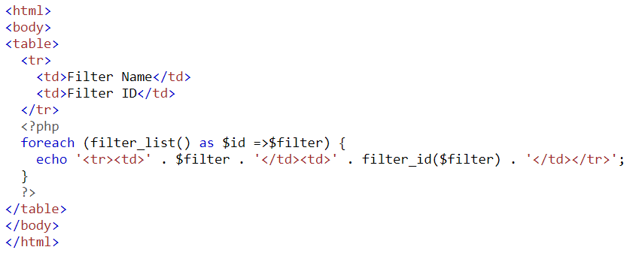
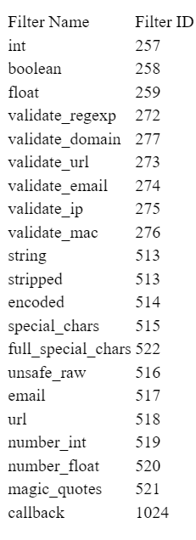
PHP Filters
The filter_list() function can be used to list what the PHP filter extension offers.

Slide 40
PHP Filters
The filter_var() function both validate and sanitize data.
The filter_var() function filters a single variable with a specified filter.
It takes two pieces of data:
The variable you want to check
The type of check to use

Slide 41
PHP Filters
<html>
<body>
<?php
$str = "<h1>Hello World!</h1>";
$newstr = filter_var($str, FILTER_SANITIZE_STRING);
echo $newstr;
?>
</body>
</html>
Output: Hello World!

Slide 42
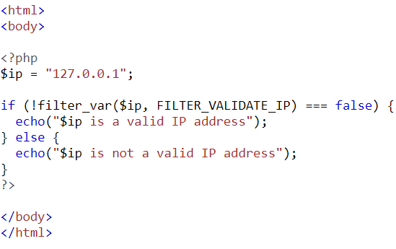
PHP Filters

Slide 43
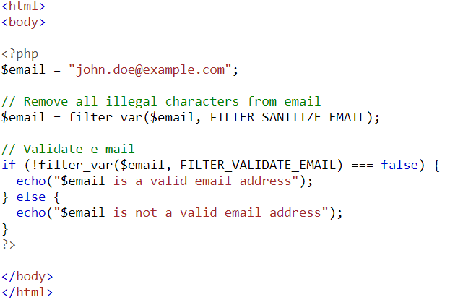
PHP Filters

Slide 44
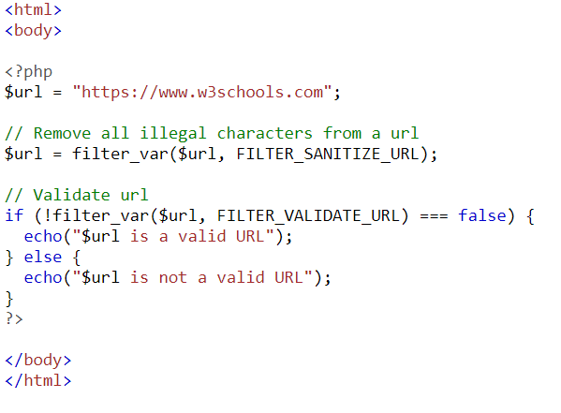
PHP Filters

Slide 45
PHP Filters Functions
filter_var_array()
Filters multiple variable i.e. array of variable
filter_has_var()
Check if the variable of specific input type exists or not
filter_id()
helps to get filter id of the specified filter name
filter_input()
Gets an external variable and filters it if set to do so.
filter_input_array()
same as filter_input() but here Gets multiple variables i.e. array of variable and filters them if set to do so.

Slide 46
PHP Filters Constants
Validate filter constants
FILTER_VALIDATE_BOOLEAN - Validates a boolean
FILTER_VALIDATE_INT - Validates an integer
FILTER_VALIDATE_FLOAT - Validates a float
FILTER_VALIDATE_REGEXP - Validates a regular expression
FILTER_VALIDATE_IP - Validates an IP address
FILTER_VALIDATE_EMAIL - Validates an e-mail address
FILTER_VALIDATE_URL - Validates an URL

Slide 47
PHP Filters Constants
Sanitize filter constants
FILTER_SANITIZE_EMAIL - Removes all illegal characters from an e-mail address
FILTER_SANITIZE_ENCODED - Removes/Encodes special characters
FILTER_SANITIZE_MAGIC_QUOTES - Apply addslashes() function
FILTER_SANITIZE_NUMBER_FLOAT - Remove all characters, except digits, +- and optionally .,
FILTER_SANITIZE_NUMBER_INT - Removes all characters except digits and + –

Slide 48
PHP Filters Constants
Sanitize filter constants
FILTER_SANITIZE_SPECIAL_CHARS - Removes special characters
FILTER_SANITIZE_FULL_SPECIAL_CHARS - Encoding quotes can be disabled by using FILTER_FLAG_NO_ENCODE_QUOTES.
FILTER_SANITIZE_STRING - Removes tags/special characters from a string
FILTER_SANITIZE_STRIPPED - Alias of FILTER_SANITIZE_STRING
FILTER_SANITIZE_URL - Removes all illegal character from s URL

Slide 49
PHP Filters Constants
Other filter constants
FILTER_UNSAFE_RAW - Do nothing, optionally strip/encode special characters
FILTER_CALLBACK - Call a user-defined function to filter data

Slide 50
PHP Error and Exceptions
Error is a mistake in a program that may be caused by writing incorrect syntax or incorrect code. An error message is displayed on your browser containing the filename along with location, a message describing the error, and the line number in which error has occurred.
There are usually different types of error. In PHP, mainly four types of errors are considered:
Syntax Error or Parse Error: A syntax error is a mistake in the syntax of source code, which can be done by programmers due to their lack of concern or knowledge.
Fatal Error: A fatal error is another type of error, which is occurred due to the use of undefined function.
Warning Error: The warning error does not stop/prevent the execution of the program
Notice Error: Notice error is same as warning error.

Slide 51
Errors
Error
An Error is an unexpected program result, which can not be handled by the program itself.
That can be solved by using the issue in the code manually.
An Error can be an infinite loop that can not be handled by the program itself so you have to manually repair that issue.
There is an easy procedure to handle error i.e. using die() function.
die("message")

Slide 52
Error
<?php
// Open file in read mode
$file_var = fopen("myfile.txt", "r");
// Check for file existence
if (!file_exists("myfile.txt")) {
die("Sorry Error!! file does not exists");
}
else {
fopen("myfile.txt", "r");
}
?>

Slide 53
Creating a Custom Error Handler
Parameter | Description
error_level | Required. Specifies the error report level for the user-defined error. Must be a value number. See table below for possible error report levels
error_message | Required. Specifies the error message for the user-defined error
error_file | Optional. Specifies the filename in which the error occurred
error_line | Optional. Specifies the line number in which the error occurred
error_context | Optional. Specifies an array containing every variable, and their values, in use when the error occurred

Slide 54
Creating a Custom Error Handler
We simply create a special function that can be called when an error occurs in PHP.
This function must be able to handle a minimum of two parameters (error level and error message) but can accept up to five parameters (optionally: file, line-number, and the error context)
error_function(error_level,error_message, error_file, error_line, error_context)

Slide 55
Error Report levels
These error report levels are the different types of error the user-defined error handler can be used for
Value | Constant | Description
1 | E_ERROR | A fatal run-time error. Execution of the script is stopped
2 | E_WARNING | A non-fatal run-time error. Execution of the script is not stopped
8 | E_NOTICE | A run-time notice. The script found something that might be an error, but could also happen when running a script normally
256 | E_USER_ERROR | A fatal user-generated error. This is like an E_ERROR, except it is generated by the PHP script using the function trigger_error()

Slide 56
Error Report levels
These error report levels are the different types of error the user-defined error handler can be used for
Value | Constant | Description
512 | E_USER_WARNING | A non-fatal user-generated warning. This is like an E_WARNING, except it is generated by the PHP script using the function trigger_error()
1024 | E_USER_NOTICE | A user-generated notice. This is like an E_NOTICE, except it is generated by the PHP script using the function trigger_error()
2048 | E_STRICT | Not strictly an error.
8191 | E_ALL | All errors and warnings (E_STRICT became a part of E_ALL in PHP 5.4)

Slide 57
Set Error Handler
The default error handler for PHP is the built in error handler. We are going to make the function above the default error handler for the duration of the script.
It is possible to change the error handler to apply for only some errors, that way the script can handle different errors in different ways.
However, in this example we are going to use our custom error handler for all errors:
set_error_handler("customError");

Slide 58
Exceptions
Exception
An Exception also is an unexpected result of a program but Exception can be handled by the program itself by throwing another exception.
Exceptions should only be used with error conditions, where the error is non removal.
There is an easy way to overcome the Exception by using try and catch method.
try { }
catch( ) { }

Slide 59
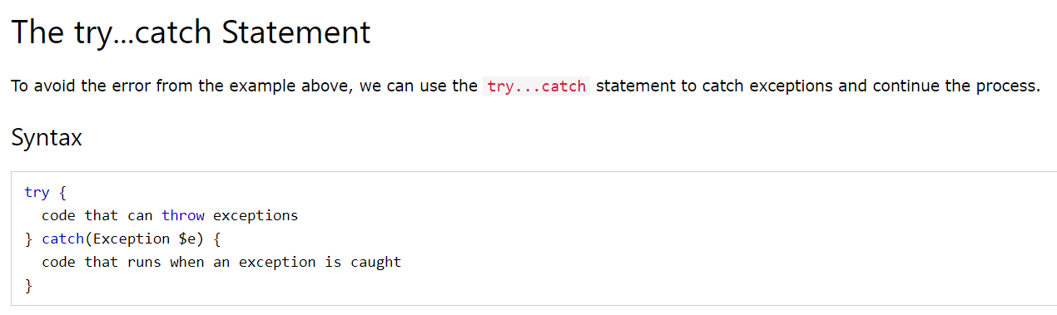
PHP error handling keywords
Try: The try block contains the code that may potentially throw an exception. All of the code within the try block is executed until an exception is potentially thrown.
Catch: This block of code will be called only if an exception occurs within the try code block. The code within your catch statement must handle the exception that was thrown.

Slide 60
PHP try.. catch
<html>
<body>
<?php
function divide($dividend, $divisor) {
if($divisor == 0) {
throw new Exception("Division by zero");
}
return $dividend / $divisor;
}
try {
echo divide(15, 2);
} catch(Exception $e) {
echo "Unable to divide.";
}?>
</body></html>

Slide 61
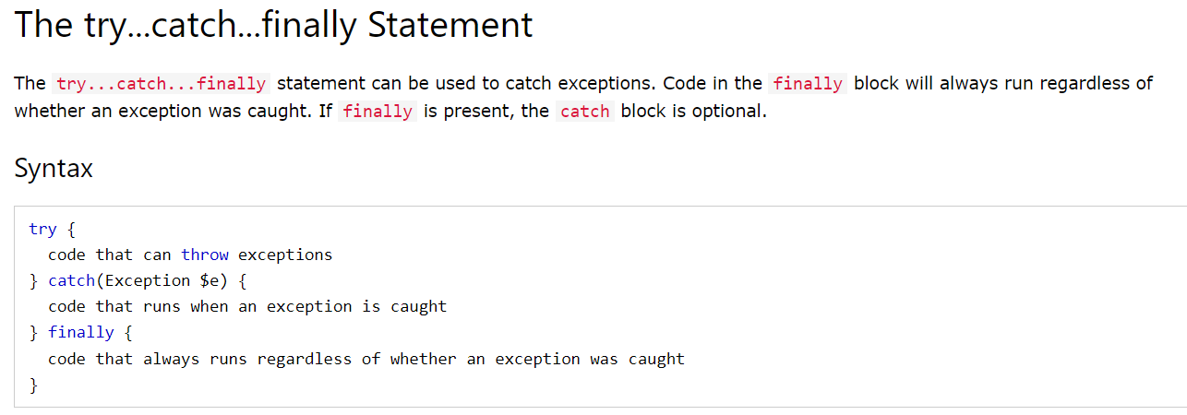

Slide 62
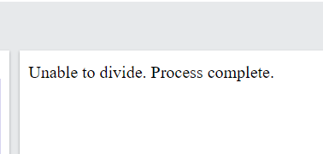
<html>
<body>
<?php
function divide($dividend, $divisor) {
if($divisor == 0) {
throw new Exception("Division by zero");
}
return $dividend / $divisor;
}
try {
echo divide(5, 0);
} catch(Exception $e) {
echo "Unable to divide. ";
} finally {
echo "Process complete.";
}
?></body></html>

Slide 63
PHP error handling keywords
Throw: The throw keyword is used to signal the occurrence of a PHP exception. The PHP runtime will then try to find a catch statement to handle the exception.

Slide 64
Exception
<?php
function valid_division($x, $y) {
if($y != 0) {
return true;
}
else {
throw new Exception("Why should not be equal to 0");
} }
try {
valid_division(2, 0);
// Try block will only run if there is no exception
echo "Valid division";
} catch(Exception $e) {
// Catch block will run if an exception occurs
echo "Error\n";
echo $e->getmessage();
}
?>

Slide 65
Creating custom PHP exception types
PHP also allows creating custom exception types. This can be useful for creating custom exceptions in your application that you can have special exception handling around.
To create a custom exception handler, we must create a special class with functions that can be called when an exception occurs. The class must be an extension of the exception class.
class DivideByZeroException extends Exception {};

Slide 66
Error Vs Exception
Error are the procedural approach. | Exceptions are an object-oriented approach to programming.
The default error handling in PHP is very simple. | Exceptions are used to change the normal flow of a script if a specified error occurs.
This can be done using PHP die() Function. | Basic Exception Handling using throw new Exception() in case of advance Exception handling you have to use try and catch method.

Slide 67
PHP File handling
File handling is an important part of any web application. You often need to open and process a file for different tasks.
PHP has several functions for creating, reading, uploading, and editing files.
A better method to open files is with the fopen() function.
The first parameter of fopen() contains the name of the file to be opened and the second parameter specifies in which mode the file should be opened.
The readfile() function reads a file and writes it to the output buffer-returns the number of bytes read on success.
fclose() close the file.

Slide 68
PHP File handling
Modes | Description
r | Open a file for read only. File pointer starts at the beginning of the file
w | Open a file for write only. Erases the contents of the file or creates a new file if it doesn't exist. File pointer starts at the beginning of the file
a | Open a file for write only. The existing data in file is preserved. File pointer starts at the end of the file. Creates a new file if the file doesn't exist
x | Creates a new file for write only. Returns FALSE and an error if file already exists
r+ | Open a file for read/write. File pointer starts at the beginning of the file
w+ | Open a file for read/write. Erases the contents of the file or creates a new file if it doesn't exist. File pointer starts at the beginning of the file
a+ | Open a file for read/write. The existing data in file is preserved. File pointer starts at the end of the file. Creates a new file if the file doesn't exist
x+ | Creates a new file for read/write. Returns FALSE and an error if file already exists

Slide 69
PHP File handling
The fread() function reads from an open file.
The first parameter of fread() contains the name of the file to read from and the second parameter specifies the maximum number of bytes to read.
fread($myfile,filesize(“test.txt"));
The fclose() function is used to close an open file.
The fclose() requires the name of the file (or a variable that holds the filename) we want to close.
fclose($myfile);

Slide 70
PHP File handling
Uploading files to a web server is a subject that seems daunting to many people, but it actually couldn’t be much easier.
All you need to do to upload a file from a form is choose a special type of encoding called multipart/form-data, and your browser will handle the rest.
Five things are stored in the $_FILES array when a file is uploaded
Array element Contents
$_FILES['file']['name'] The name of the uploaded file (e.g., smiley.jpg)
$_FILES['file']['type'] The content type of the file (e.g., image/jpeg)
$_FILES['file']['size'] The file’s size in bytes
$_FILES['file']['tmp_name'] The name of the temporary file stored on the
server
$_FILES['file']['error'] The error code resulting from the file upload

Slide 71
PHP File handling
If you use fopen() on a file that does not exist, it will create it, given that the file is opened for writing (w) or appending (a).
The feof() function checks if the "end-of-file" (EOF) has been reached.
The fgetc() function is used to read a single character from a file and fgets() function is used to read single line.
The first parameter of fwrite() contains the name of the file to write to and the second parameter is the string to be written.
The copy() function copies a file - copy(from_file, to_file, context)

Slide 72
PHP File handling
The PHP unlink() function is used to delete file.
unlink('data.txt');
To determine whether a file already exists, you can use the file_exists function, which returns either TRUE or FALSE, and is used like this:
if (file_exists("testfile.txt")) echo "File exists";
The die () is an inbuilt function in PHP.
It is used to print message and exit from the current php script.
It is equivalent to exit () function in PHP.

Slide 73
PHP File handling
The easiest way to read from a text file is to grab a whole line through fgets (think of the final s as standing for string)
We can retrieve multiple lines or portions of lines through the fread function.
To move a file, rename it with the rename function.
Update - want to add more data to a saved file
the append write modes or
you can simply open a file with one of the other modes that supports writing, and
move the file pointer to the correct place within the file that you wish to write to or read from.

Slide 74
PHP File handling
The file pointer is the position within a file at which the next file access will take place, whether it’s a read or a write.
It is not the same as the file handle which contains details about the file being accessed.
A handy function for reading in an entire file without having to use file handles is file_get_contents
echo file_get_contents("testfile.txt");

